Slide 1
INTRODUCTION TO COMPUTING
Course Code: CCINCOM/L
Data Wrangling
Elizer Ponio Jr
Faculty
Department of Computer Science
College of Computing and Information Technologies (CCIT)
National University
Joseph Marvin R. Imperial
DATA SCIENCE 1
NU College of Computing and Information Technologies
COURSE CODE: CCDATSC1L

Slide 2
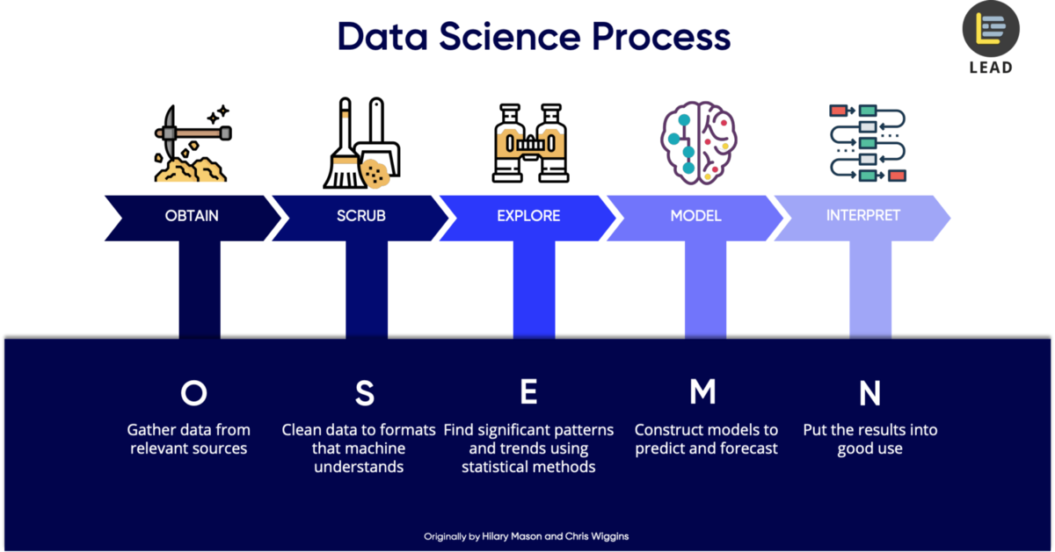
Introduction to the Science of Data
Joseph Marvin R. Imperial
DATA SCIENCE 1
NU College of Computing and Information Technologies
COURSE CODE: CCDATSC1L

Slide 3
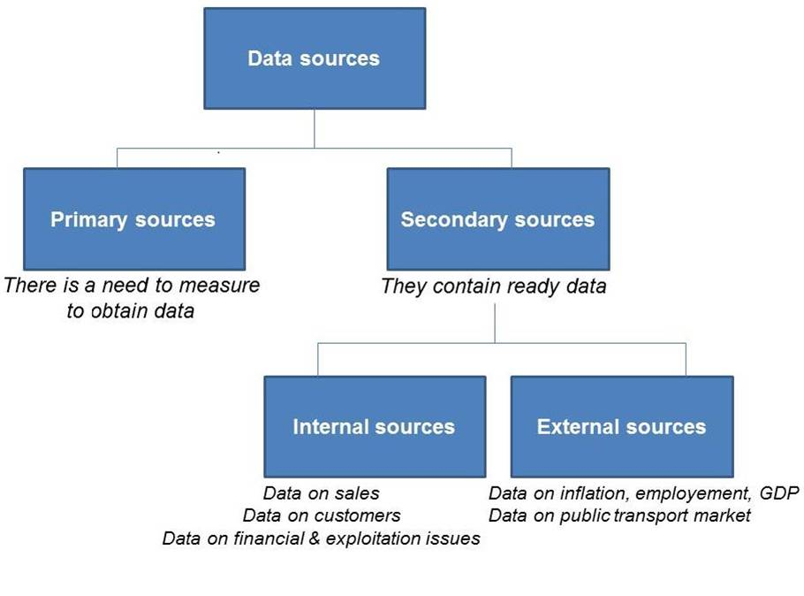
Data Collection
the process of gathering and measuring information on variables of interest, in an established systematic fashion that enables one to answer stated research questions, test hypotheses, and evaluate outcomes.
Possibly the most time consuming and expensive part of any data science / research task aside from cleaning.
Introduction to the Science of Data
Joseph Marvin R. Imperial
DATA SCIENCE 1
NU College of Computing and Information Technologies
COURSE CODE: CCDATSC1L

Slide 4
Risks in Data Collection
Giving away a lot of personal data gives a lot of power to the person / company collecting it. Case to case basis.
Unintentional collection of copyrighted data. Often happens in collecting data online.
Collecting data does not infinitely lead to more value. Instead, returns of scale on data will eventually decrease as the information will stop being relevant to what you are trying to achieve.
Collecting blindly without establishing a goal beforehand, will complicate the differentiation between valuable and dispensable data. Know what you want to collect.
The risks of collecting data indiscriminately are real. But done properly, the benefits are equally evident (Accenture).
Introduction to the Science of Data
Joseph Marvin R. Imperial
DATA SCIENCE 1
NU College of Computing and Information Technologies
COURSE CODE: CCDATSC1L

Slide 5
Best Practices in Data Collection
Your data sets need to be checked and cross referenced for data quality and integrity.
You have to know the rules and regulations of websites or applications where data will be collected.
You have to ensure people’s rights to consent, privacy, security and ownership around the information processes of collection, analysis, storage, presentation and reuse of data, while respecting the values of transparency and openness.
You need to safeguard your data. Data breaches have serious negative effects on your business, your image, and the safety of your respondents.
In some cases, you need to be transparent. People want to know how and why you are collecting their data. So, tell them. Allow users to opt in or out of data collection, and tell them exactly how the information will be used.
Introduction to the Science of Data
Joseph Marvin R. Imperial
DATA SCIENCE 1
NU College of Computing and Information Technologies
COURSE CODE: CCDATSC1L

Slide 6
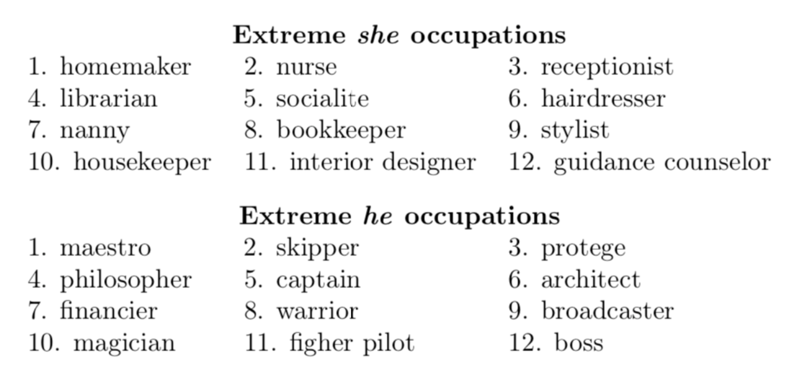
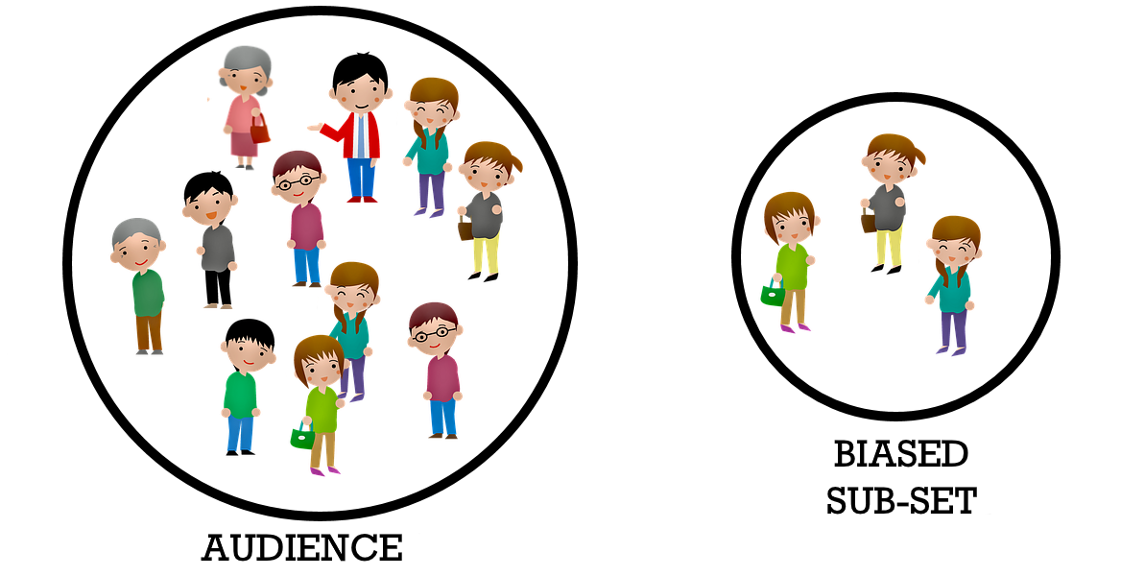
Bias in your data?
Bias starts with the data. Humans are already biased by nature.
Big datasets and models trained with these datasets are (100%) biased.
The most important aspect of a statistical analysis is not what you do with the data, it’s what data you use.
Introduction to the Science of Data
Joseph Marvin R. Imperial
DATA SCIENCE 1
NU College of Computing and Information Technologies
COURSE CODE: CCDATSC1L

Slide 7
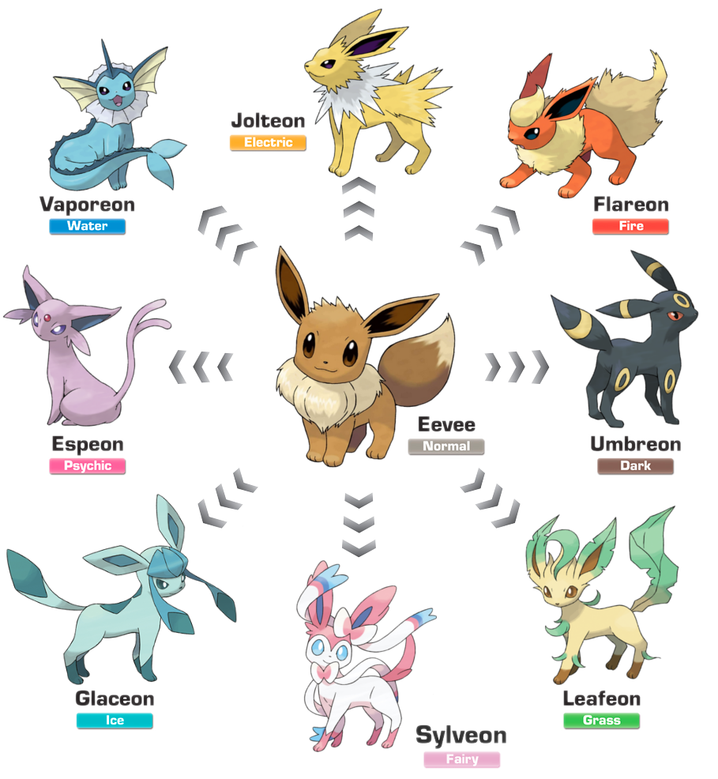
Raw data is in all forms and sizes
They may come in various formats you can think of.
CSV, jpeg, PDF, docx, flac.
Conversions may be needed along the way.
They may have contents that is not entirely useful.
Spaces, nulls, NANs, tabs
They may contain outliers and anomalies.
Ex. Age 300
They may not make any sense at all unless a human intervenes.
How do you deal with all of them?
Introduction to the Science of Data
Joseph Marvin R. Imperial
DATA SCIENCE 1
NU College of Computing and Information Technologies
COURSE CODE: CCDATSC1L

Slide 8
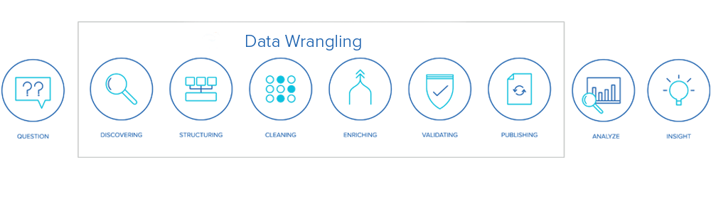
Data Wrangling
Data wrangling, sometimes referred to as data munging, is the process of transforming and mapping data from one "raw" data form into another format with the intent of making it more appropriate and valuable for a variety of downstream purposes such as analytics.
Introduction to the Science of Data
Joseph Marvin R. Imperial
DATA SCIENCE 1
NU College of Computing and Information Technologies
COURSE CODE: CCDATSC1L

Slide 9
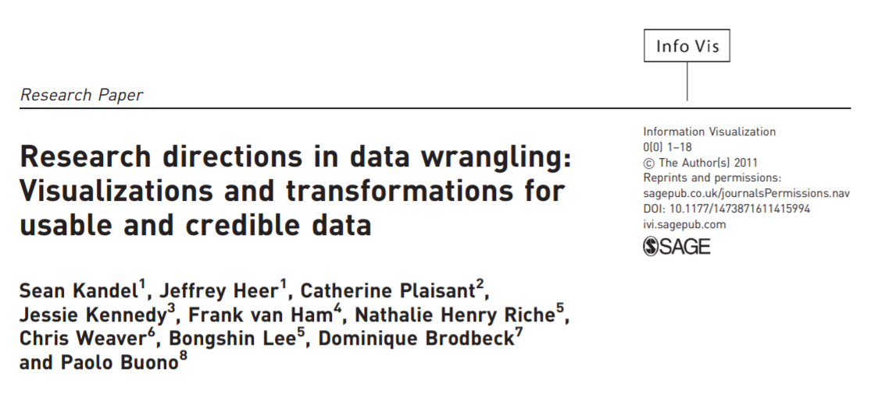
Data Wrangling
http://vis.stanford.edu/files/2011-DataWrangling-IVJ.pdf
Introduction to the Science of Data
Joseph Marvin R. Imperial
DATA SCIENCE 1
NU College of Computing and Information Technologies
COURSE CODE: CCDATSC1L

Slide 10
Data Wrangling Tasks
Combine multiple data sources.
Work with anomalies and outliers.
Transform data from one format to the other.
Impute or fill up missing data.
Improve efficiency and scale of data importing.
Combine automation with interactive visualizations to aid in cleaning.
And most importantly, ensure quality data.
Introduction to the Science of Data
Joseph Marvin R. Imperial
DATA SCIENCE 1
NU College of Computing and Information Technologies
COURSE CODE: CCDATSC1L

Slide 11
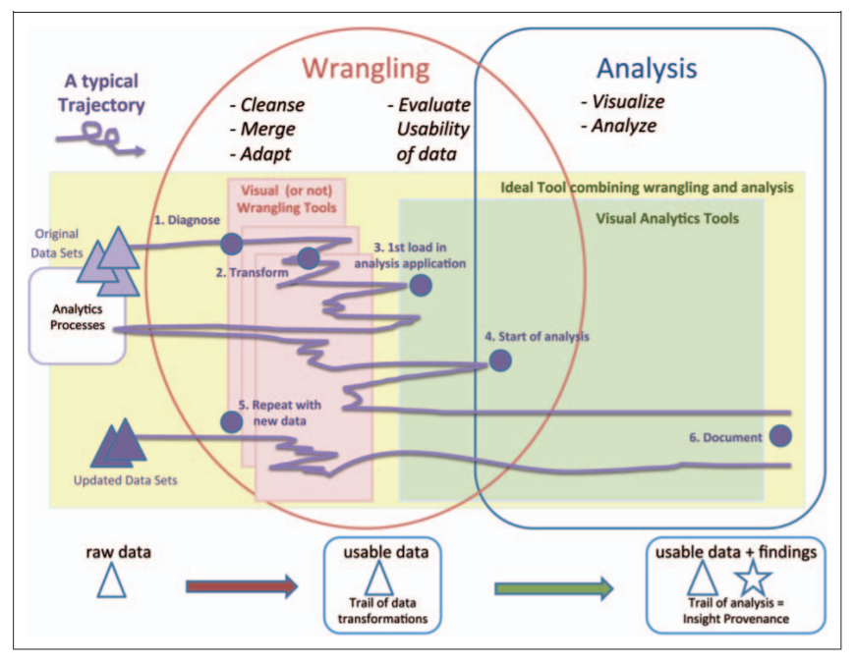
Introduction to the Science of Data
The wrangling and analysis phases overlap. Much wrangling may need to take place before the data can be loaded within visualization and analysis tools, which typically immediately reveals new problems with the data. Wrangling might take place at all the stages of analysis as users sort out interesting insights from dirty data, or new data become available or needed.
Joseph Marvin R. Imperial
DATA SCIENCE 1
NU College of Computing and Information Technologies
COURSE CODE: CCDATSC1L

Slide 12
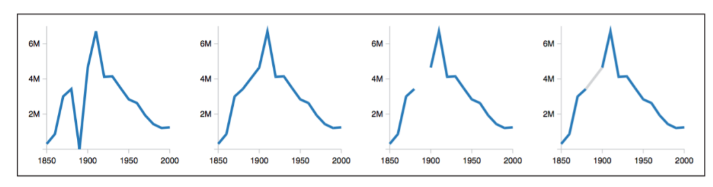
Diagnosing Data Problems
Preliminary visualizations can convey “raw” data.
Different visual representations highlight different types of data issues.
Outliers often stand out in a plot.
Missing data will cause gap or zero value.
Becomes increasingly difficult as data gets larger.
Do sampling.
Introduction to the Science of Data
Joseph Marvin R. Imperial
DATA SCIENCE 1
NU College of Computing and Information Technologies
COURSE CODE: CCDATSC1L

Slide 13
Transforming Data
Interactive tools simplify the process. Use and expand your toolbox.
Data formatting, extraction, and conversion.
Regular expressions.
OCR
NLP tools
Correcting erroneous values.
Outlier detection, missing value imputation, and resolving duplicate records.
Integrating multiple data sets.
Remember to audit your transformations (data provenance).
Track the lineage of a specific item’s origins.
Maintain transformation history.
Introduction to the Science of Data
Joseph Marvin R. Imperial
DATA SCIENCE 1
NU College of Computing and Information Technologies
COURSE CODE: CCDATSC1L

Slide 14
Correcting Erroneous Data
Although automated outlier detection can highlight potential errors in the data, human judgement is often necessary to verify these errors and choose an appropriate transform to correct them.
An analyst could decide to remove only specific outliers or decide to set bounds on the data values. Interaction is needed to accelerate these iterative loops of assessment and action
A human-in-the-loop process.
Introduction to the Science of Data
Joseph Marvin R. Imperial
DATA SCIENCE 1
NU College of Computing and Information Technologies
COURSE CODE: CCDATSC1L

Slide 15
Data Wrangling in the Cloud
Allows the sharing of data transformations.
By deploying wrangling tools on the public web, a large audience (analysts, journalists, activists, and others) might share their transformations, and thereby further open data access.
Feedback from downstream analysts.
Downstream analysts or visualization users, who might not have been involved in the initial data preparation, may also discover data errors.
Introduction to the Science of Data
Joseph Marvin R. Imperial
DATA SCIENCE 1
NU College of Computing and Information Technologies
COURSE CODE: CCDATSC1L

Slide 16
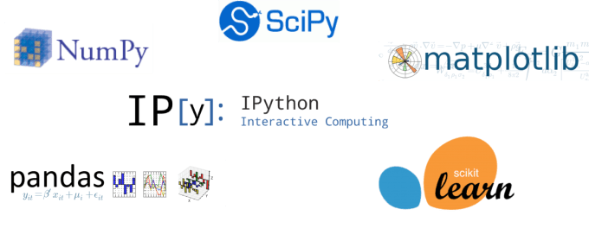
Tools for Data Wrangling
Introduction to the Science of Data
Joseph Marvin R. Imperial
DATA SCIENCE 1
NU College of Computing and Information Technologies
COURSE CODE: CCDATSC1L

Slide 17
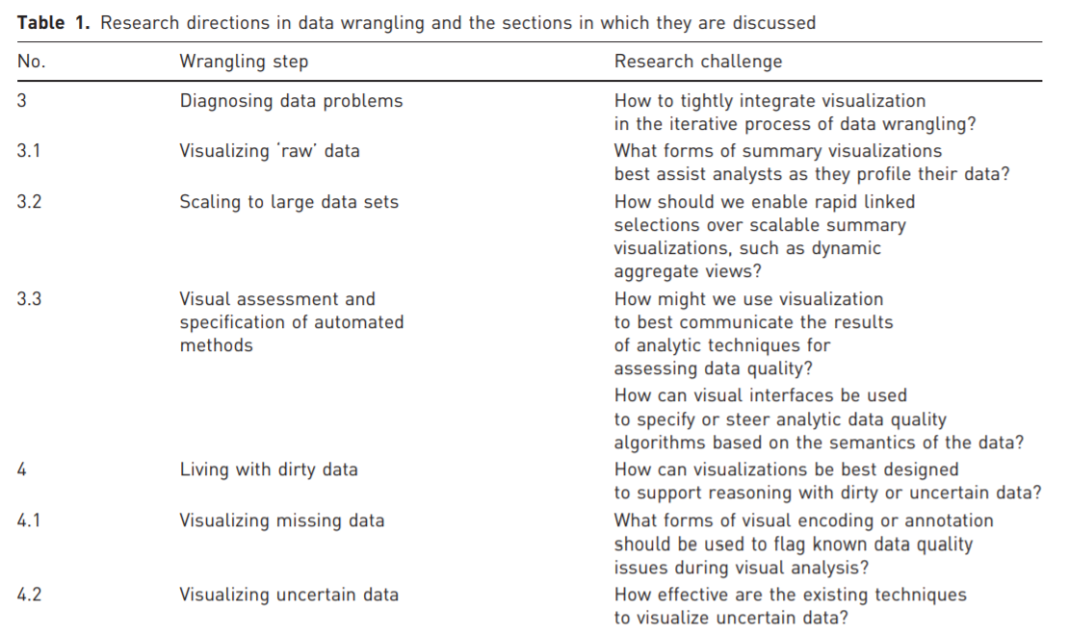
Introduction to the Science of Data
Joseph Marvin R. Imperial
DATA SCIENCE 1
NU College of Computing and Information Technologies
COURSE CODE: CCDATSC1L

Slide 18
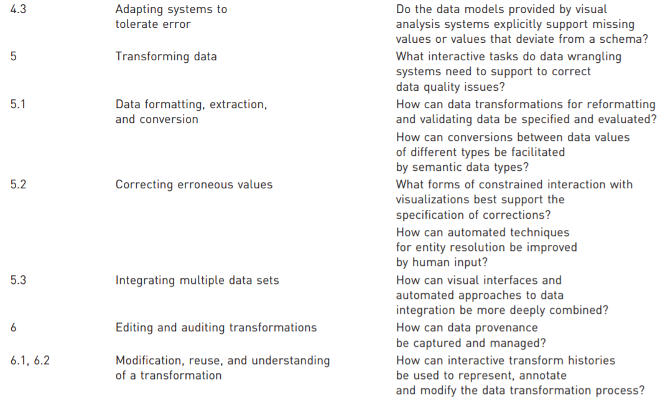
Introduction to the Science of Data
Joseph Marvin R. Imperial
DATA SCIENCE 1
NU College of Computing and Information Technologies
COURSE CODE: CCDATSC1L

Slide 19
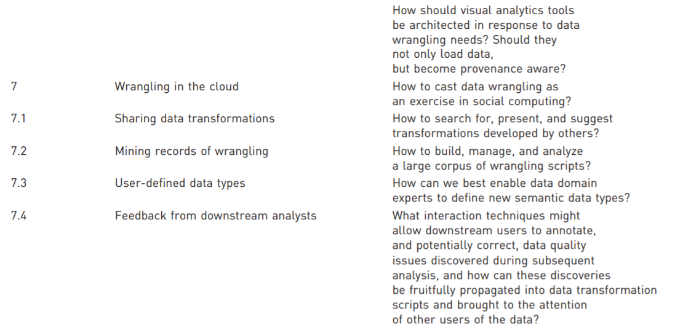
Introduction to the Science of Data
Joseph Marvin R. Imperial
DATA SCIENCE 1
NU College of Computing and Information Technologies
COURSE CODE: CCDATSC1L

Slide 20
References
University of Helsinki. Introduction to Data Science course.
Johns Hopkins University. Advanced Data Science course.
Introduction to the Science of Data
Joseph Marvin R. Imperial
DATA SCIENCE 1
NU College of Computing and Information Technologies
COURSE CODE: CCDATSC1L

